Slide 1


NOVY MART ANALYSIS

Slide 2
Problem Statement
Novy Mart is a retail giant with over 50 supermarkets in the southern region of India. All their 50 stores ran a massive Promotion during the Diwali 2023 and Sankranti 2024(Festive time of India) on their Novy branded products. Now the Sales director wants to understand which promotion did well and which did not so they can make informed decision for their next promotional period.

Slide 3

Provide a list of products with a base price greater than 500 and that are featured in promo type of ‘BOGOF’(BUY ONE GET ONE FREE). This information will help us identify high value products that are currently being heavily discounted, which can be useful for evaluating our pricing and promotion strategies.
Novy Double Bedsheet set and Novy waterproof Immersion Rod are the products where base price greater than 500 and that are featured in promo type pf ‘BOGOF’(BUY ONE GET ONE FREE).

Slide 4
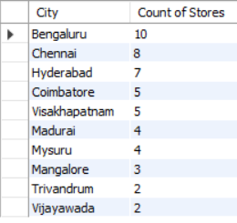
Generate a report that provides an overview of the number of stores in each city. The result will be sorted in descending order of store counts, allowing us to identify the cities with the highest store presence. The report includes two essential field: city and store count, Which will assist in optimizing our retail operations.
Bengaluru has the highest number of stores which is 10.
Followed by Chennai which is second highest, has 8 stores.
Followed by Hyderabad which is third highest, has 7 stores.
Followed by Coimbatore, Visakhapatnam, Madurai, Mysuru, Mangalore, Trivandrum, Vijayawada have between 2 and 5 no. of stores.

Slide 5

Generate a report that displays each campaign along with total revenue generated before and after the campaign? The report include three key fields: Campaign -Name, Total - Revenue (Before -Promotion),Total Revenue (After-Promotion). This report should help in evaluating the financial impact of our campaigns. (Display the values in millions).
In Diwali Campaign, the company has generated Total Revenue Before Promotion which is 82.57 Million and Total Revenue After Promotion which is 207.46 Million, It represents after promotion the company sees growth.
In Sankranti Campaign, the company has generated Total Revenue Before Promotion which is 58.13 Million and Total Revenue After Promotion which is 140.40 Million, It represents after promotion the company sees growth.

Slide 6
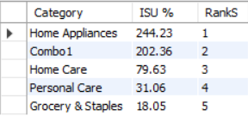
Produce a report that calculates incremental sold quantity(ISU%) for each category during the Diwali Campaign. Additionally, provide rankings for the category based on their ISU%. The report will include three key fields: category, ISU%, Rank Order.
In category of Home Appliances has made the highest ISU% which is 244.23%.
Followed by Combo1 has made the second highest ISU% which is 202.36%.
Followed by Home Care has made the third highest ISU% which is 79.63%.
Followed by Personal Care has made the fourth highest ISU% which is 31.06%.
Followed by Grocery & Staples has made the fifth highest ISU% which is 18.05%.

Slide 7
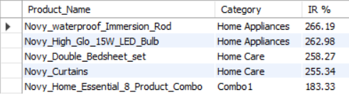
Create a report featuring the Top 5 products ,ranked by Incremental Revenue Percentage(IR%),across all campaigns. The report will provide essential information including product name, category and IR%. This analysis helps identify the most successful products in terms of incremental revenue across our campaigns, assisting in product optimization.

Slide 8
Thank You !

